Slide 1
React.JS
Lecture 25
React Forms

Slide 2
Forms

Slide 3
Types of React Forms
React supports two types of components:
Controlled components
Uncontrolled components.
React recommends using controlled components to implement forms.
In a controlled component, form data is handled by a React component.
In uncontrolled components, form data is handled by the DOM itself.

Slide 4
Controlled Components
In a controlled component, the form data is handled by the state within the component.
The state within the component serves as “the single source of truth” for the input elements that are rendered by the component.
In HTML, form elements such as <input>, <textarea>, and <select> maintain their own state and update it based on user input.
In React, mutable state is typically kept in the state property of components, and only updated with setState().

Slide 5
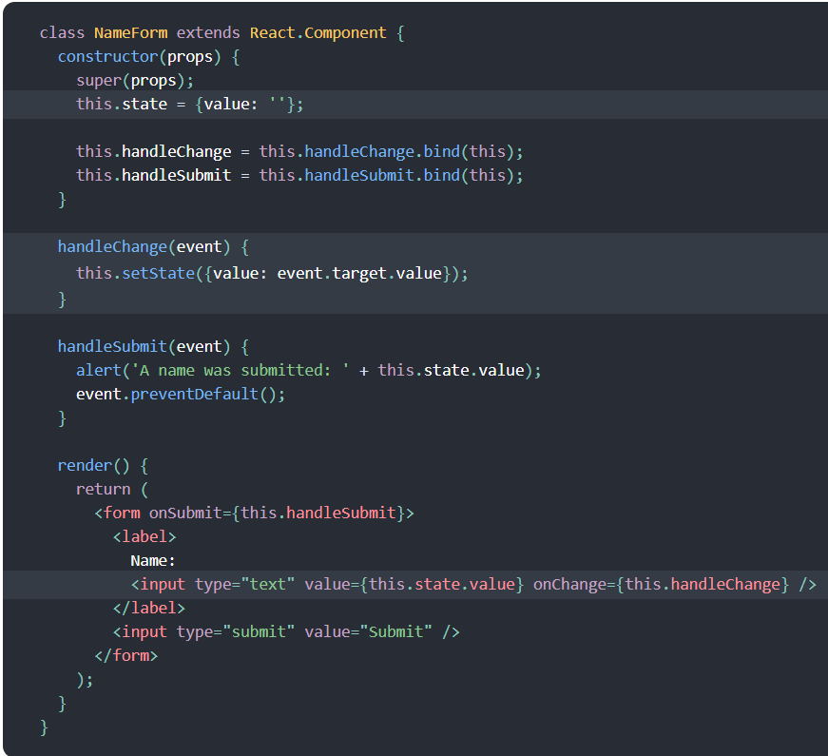

Slide 6
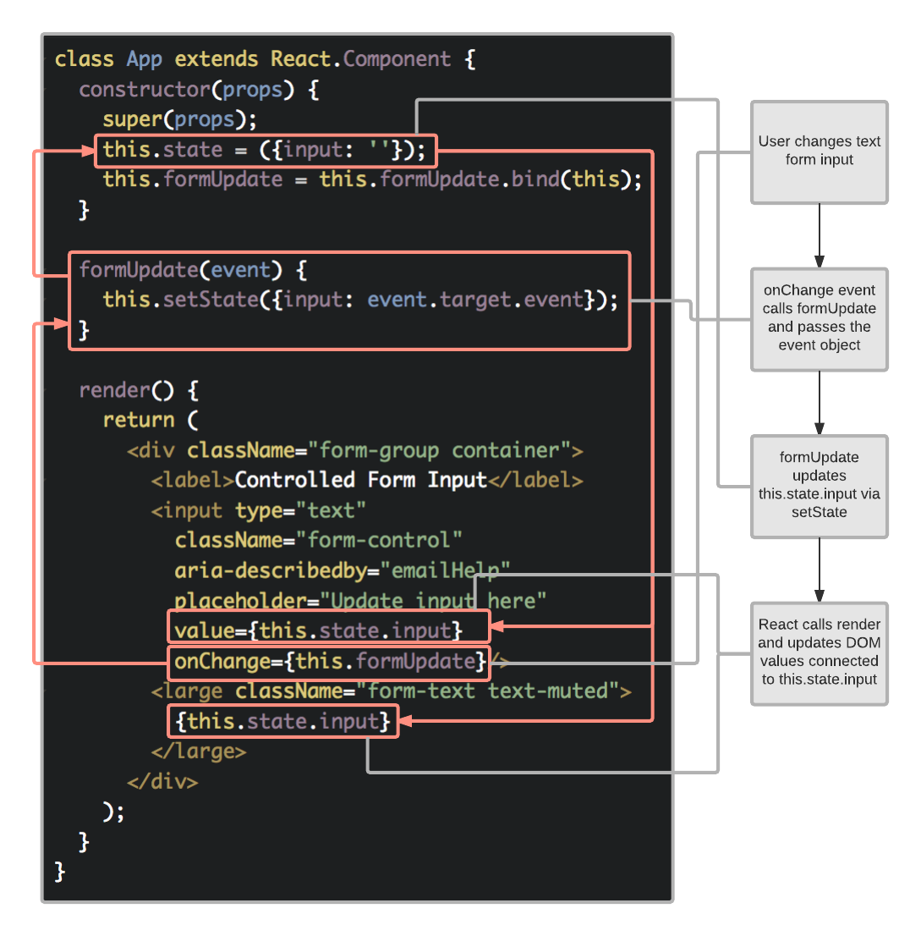

Slide 7
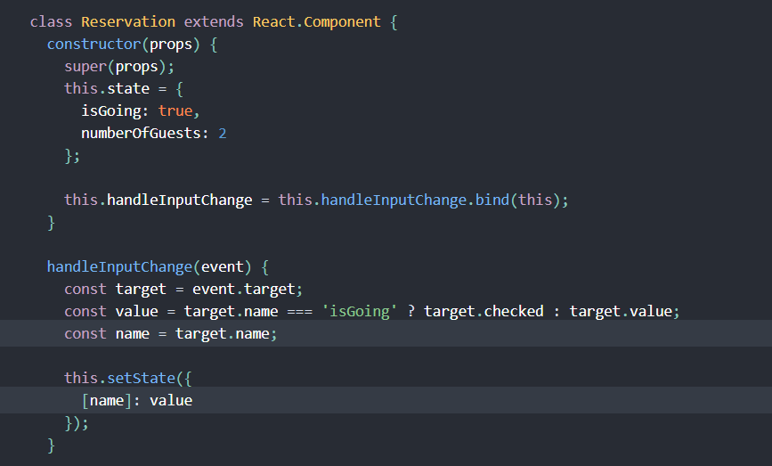
Handling Multiple inputs

Slide 8
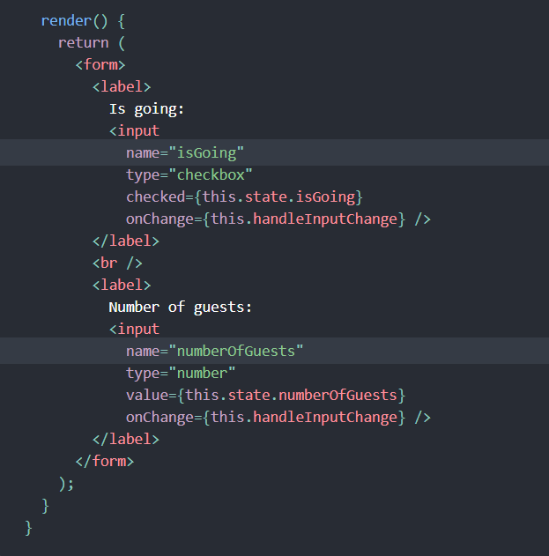

Slide 9
Uncontrolled Forms
Uncontrolled components act more like traditional HTML form elements.
The data for each input element is stored in the DOM, not in the component.
Instead of writing an event handler for all of your state updates, you use a ref to retrieve values from the DOM.
Refs provide a way to access DOM nodes or React elements created in the render method.

Slide 10
Controlled or uncontrolled?
Use controlled components whenever possible.
Controlled components do not require a form element in order to be considered a controlled component.
If a component has an input element that has a value attribute bound to state and an event handler to update said state, it is a controlled component.
For pages that have a large number of input elements, it can be cumbersome to work with controlled components.
Data flow is uni-directional in controlled components with the state within the component acting as the single source of truth.
All state changes within a controlled component should be made via the setState function.

Slide 11
Continue…..
Uncontrolled components store their data in the DOM like a traditional HTML input element.
React.createRef() is used to create instance variables within uncontrolled component constructors. These variables are then associated with input elements via the ref attribute.
Refs cannot be used on functional components as there is no instance.

Slide 12
Using Hooks

Slide 13
Hooks
Hooks are functions that let you “hook into” React state and lifecycle features from function components.
Hooks don’t work inside classes — they let you use React without classes.
React provides a few built-in Hooks like useState. You can also create your own Hooks to reuse stateful behavior between different components.
It renders a counter. When you click the button, it increments the value
import React, { useState } from 'react’;
function Example() {
const [count, setCount] = useState(0);
return (
<div> <p>You clicked {count} times</p>
<button onClick={() => setCount(count + 1)}>
Click me </button> </div> ); }

Slide 14
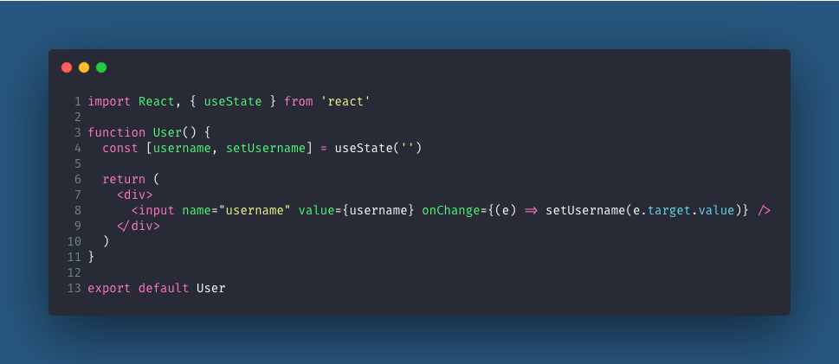
Form with functional components using hooks.

Slide 15
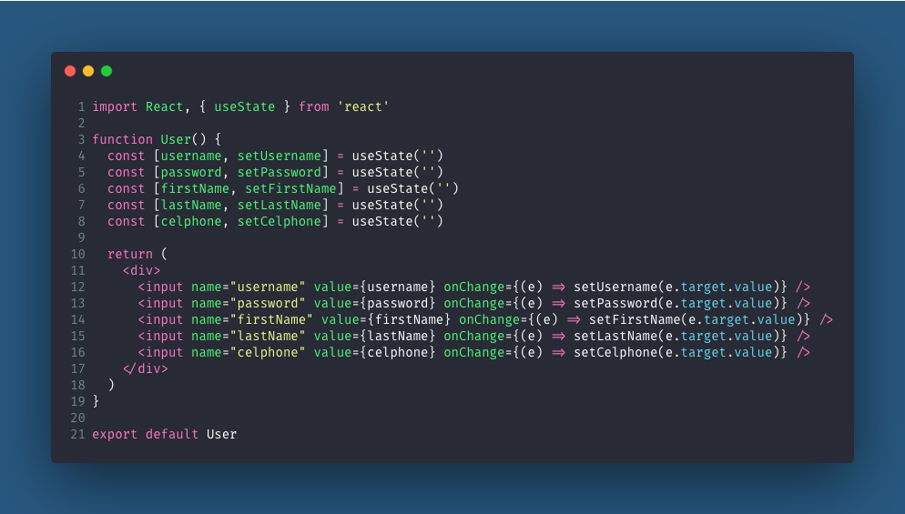
For Multiple Fields

Slide 16
React-Redux Forms
You can create forms using React-Redux state management.
First we will cover Redux part then we will again go through this form part
Wait for one lecture

Slide 17
Another Option is FormIK (Recommended by React)
Formik is a small library that helps you with the 3 most annoying parts:
Getting values in and out of form state
Validation and error messages
Handling form submission
Installation:
npm install formik –-save/yarn add formik
OR CDN
<script src="https://unpkg.com/formik/dist/formik.umd.production.js"></script>

Slide 18
import React from 'react';
import { Formik, Form, Field, ErrorMessage } from 'formik';
const Basic = () => (
<div>
<h1>Any place in your app!</h1>
<Formik
initialValues={{ email: '', password: '' }}
validate={values => {
const errors = {};
if (!values.email) {
errors.email = 'Required';
} else if (
!/^[A-Z0-9._%+-]+@[A-Z0-9.-]+\.[A-Z]{2,}$/i.test(values.email)
) {
errors.email = 'Invalid email address';
}
return errors;
}}

Slide 19
onSubmit={(values, { setSubmitting }) => {
setTimeout(() => {
alert(JSON.stringify(values, null, 2));
setSubmitting(false);
}, 400); }} >
{({ isSubmitting }) => (
<Form>
<Field type="email" name="email" />
<ErrorMessage name="email" component="div" />
<Field type="password" name="password" />
<ErrorMessage name="password" component="div" />
<button type="submit" disabled={isSubmitting}>
Submit
</button>
</Form>
)}
</Formik>
</div>
);
export default Basic;

